Slide 1
Session 06
Numbers and Strings
(http://docs.oracle.com/javase/tutorial/java/data/index.html)
(https://docs.oracle.com/javase/8/docs/)
(http://www.oracle.com/technetwork/java/javase/documentation/jdk8-doc-downloads-2133158.html)
Session 06 - Numbers and Strings
Notes:
Numbers and strings are normal data of ever program. A number entered from the keyboard is a strings of digits. This chapter will introduce utilities supported in the java.til library package which will facilitate operations on numbers, strings.

Slide 2
Objectives
Working with Numbers:
  Wrapper classes: Number, Character
  Auto boxing and unboxing .
The java.lang.Math
String class:
  Create and manipulate strings.
  Compares the String and StringBuilder classes.
Scanning Text
Formatting output
Session 06 - Numbers and Strings
Notes:
Wrapper: Lớp bo

Slide 3
Introduction
A class can contain no data field or some data fields
Some operations on numbers are critical such as converting a string to number, …
Java libraries have classes which wrap a number (primitive type) in it and support operations on numbers. They are called as wrapper classes.
String is a common data type and it is a pre-defined class in Java library.
The java.lang package contains all of them
Session 06 - Numbers and Strings
Notes:
Operations: thao tác

Slide 4
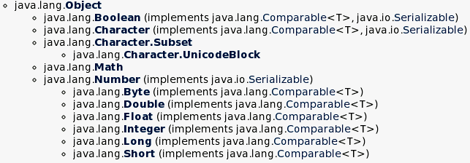
Numbers Classes
Java platform provides wrapper classes for each of the primitive data types.
All of the numeric wrapper classes are subclasses of the abstract class Number.
Session 06 - Numbers and Strings

Slide 5
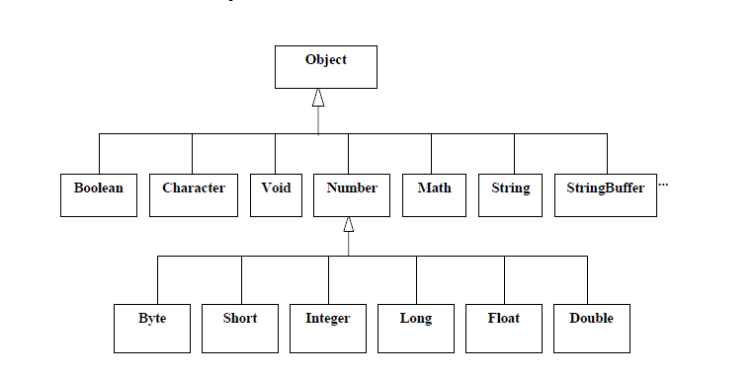
Session 06 - Numbers and Strings

Slide 6
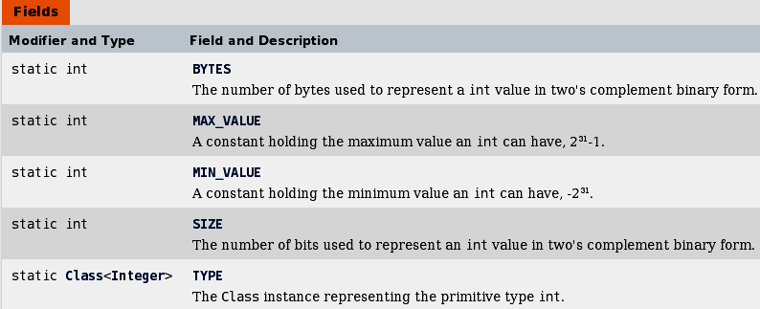
Numbers Classes: A Declaration
public final class Integer extends Number implements Comparable<Integer>
Session 06 - Numbers and Strings

Slide 7
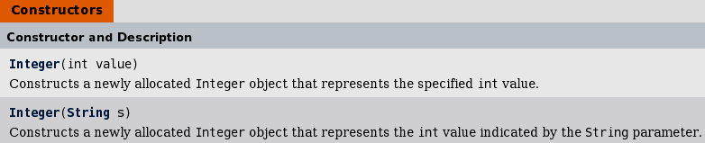
Numbers Classes: A Declaration
public final class Integer extends Number implements Comparable<Integer>
We can not create a sub-class of a wrapper class
Session 06 - Numbers and Strings

Slide 8
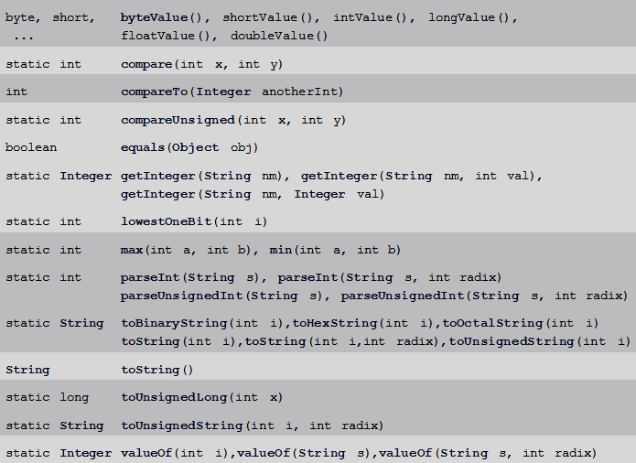
Numbers Classes: A Declaration
public final class Integer extends Number implements Comparable<Integer>
Some common methods
Wrapper classes are immutable (non-changeable) because they do not have setters
Session 06 - Numbers and Strings

Slide 9
Numbers Classes…
We use a Number object rather than a primitive when:
  As an argument of a method that expects an object.
  To use constants defined by the class, such as MIN_VALUE and MAX_VALUE.
  To use class methods for converting values to and from other primitive types.
Session 06 - Numbers and Strings

Slide 10
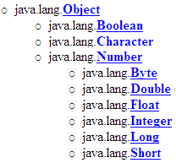
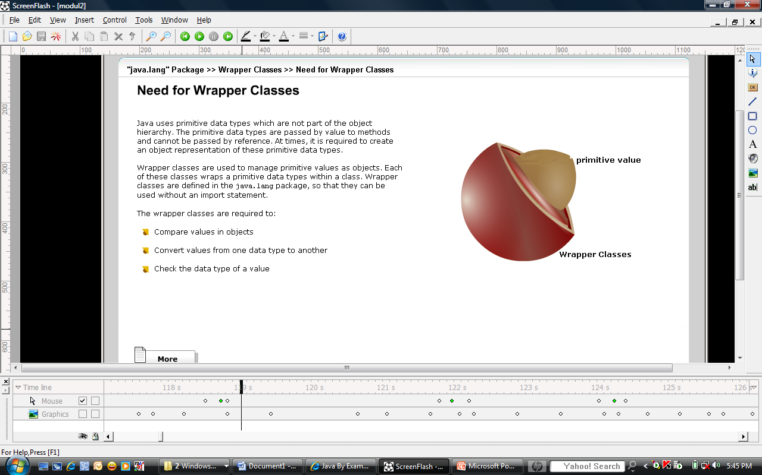
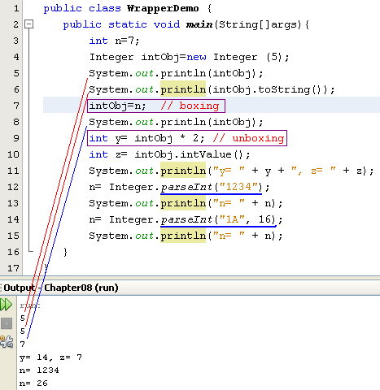

Numbers Classes- A Demo
5
obj
x 5
Boxing/auto boxing: encapsulating/wrapping a primitive value to an object.
Unboxing: get primitive value wrapped in a wrapper object.
int x= 5;
Integer obj = new Integer(5);
Integer obj2 = new Integer (“123”);
Session 06 - Numbers and Strings

Slide 11
The java.lang.Math class
The Math class in the java.lang package provides methods and constants for doing more advanced mathematical computation, including:
  Constants: Math.E, Math.PI,..
  Basic Methods: ceil(double d), floor(double d), abs(int i)…
  Exponential and Logarithmic Methods: exp(double d), sqrt(double d), pow(double base, double exponent)
  Trigonometric Methods: cos(double d), sin(double d)
  Random Numbers: The random() method returns a pseudo-randomly selected number between 0.0 and 1.0.
Session 06 - Numbers and Strings

Slide 12
Auto boxing and Unboxing (1)
Java 5.0 introduces two very simple but convenient functions that unwrap wrapper objects and wrap up primitives.
Converting a primitive value into an object of the corresponding wrapper class is called auto boxing.
Converting an object of a wrapper type to its corresponding primitive value is called unboxing.
Session 06 - Numbers and Strings

Slide 13
Auto boxing and Unboxing…
Sample of auto boxing and unboxing
  Integer wrappedInt = 25; //boxing or auto boxing
  Double area(double radius) {
    return Math.PI * radius * radius; //boxing
  }
  Integer wi = 234;
  int times9 = wi * 9; //unboxing
Session 06 - Numbers and Strings

Slide 14
Characters
Unicode character, 2 bytes
Character class also offers a number of useful class (i.e., static) methods for manipulating characters.
Character ch = new Character('a');
Some methods in this class
  boolean isLetter(char ch)/ isDigit(char ch)/ isUpperCase(char ch)
  char toUpperCase(char ch) …
A character preceded by a backslash (\) is an escape sequence and has special meaning to the compiler.
Session 06 - Numbers and Strings
Notes:
When an escape sequence is encountered in a print statement, the compiler interprets it accordingly. For example, if you want to put quotes within quotes you must use the escape sequence, \", on the interior quotes. To print the sentence
She said "Hello!" to me.
you would write
System.out.println("She said \"Hello!\" to me.");

Slide 15
Strings
Java uses the String, StringBuffer, and StringBuilder classes to encapsulate strings of characters (16-bit Unicode).
java.lang.Object
  java.lang.String (implements java.lang.CharSequence,
  java.lang.Comparable<T>, java.io.Serializable)
  java.lang.StringBuffer (implements java.lang.CharSequence,
  java.io.Serializable)
  java.lang.StringBuilder (implements
  java.lang.CharSequence, java.io.Serializable)
Interface Serializable declared methods for processing a string as a stream of characters (write string to file, …)
Session 06 - Numbers and Strings
Notes:
Encapsulate : Gói gọn
Serializable: Sự nối tiếp

Slide 16
The String Class
The String class contains an immutable string (Once an instance is created, the string it contains cannot be changed) ← No setter is implemented
Almost of it’s methods will return a new string.
Construct a string:
  String s1 = new String(“immutable”);
  String s2= new String (new char[] {‘a’, ‘b’, ‘c’});
  or
  String s3 = “immutable”;
Session 06 - Numbers and Strings
Notes:
Immutable: Không thay đổi

Slide 17
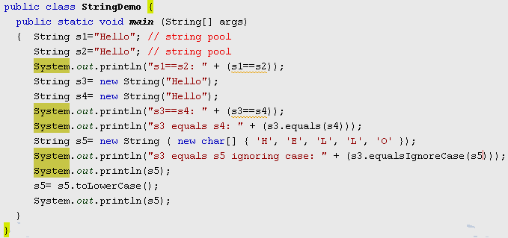
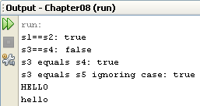
String pool
String pool
s1
Hello
s2
Shallow comparing: Compare two references
Deep comparing: Compare two values
hello
HELLO
HELLO
garbage
String pool: a way to save memory
s5
s5
Session 06 - Numbers and Strings
Notes:
Pool: Vùng chưuas

Slide 18
The String Class
Compare 2 strings: should use equals()
String st1 = “abc”;
String st2 = “xyz”;
if(st1.equals(st2)){
…
}
Session 06 - Numbers and Strings

Slide 19
The String Class
Modifier and Type | Method and Description
char | charAt(int index)
char[] | toCharArray()
byte[] | getBytes()
int | codePointAt(int index), compareTo(String anotherString) compareToIgnoreCase(String str), hashCode(),indexOf(int ch), indexOf(…),lastIndexOf(…),length()
String | trim(),toString(),concat(String str), replace(…),replaceAll(…) replaceFirst(…),substring(…), toLowerCase(…),toUpperCase(…)
static String | copyValueOf(…), format(…), valueOf(…)
boolean | contains(CharSequence s), endsWith(String suffix), startsWith(…),isEmpty(),matches(String regex) equals(Object anObject), equalsIgnoreCase(…)
void | getChars(int srcBegin, int srcEnd, char[] dst, int dstBegin)
String[] | split(String regex), split(String regex, int limit)
CharSequence | subSequence(int beginIndex, int endIndex)
Session 06 - Numbers and Strings

Slide 20
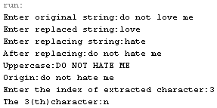
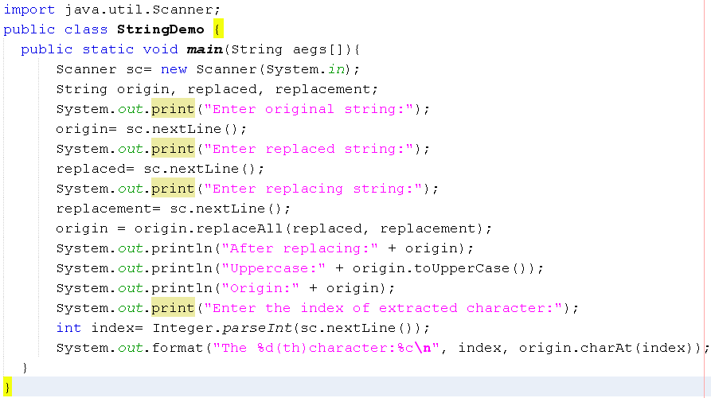
The String Class
Session 06 - Numbers and Strings

Slide 21
StringBuffer, StringBuilder Classes
Java’s StringBuffer and StringBuilder classes represent strings that can be dynamically modified.
  StringBuffer is threadsafe.
  StringBuilder (introduced in 5.0) is not threadsafe.
Almost of their methods are the same as methods in the String class.
These classes do not use string pool, thus we cannot write StringBuffer t = "ABC";
We cannot use the operator + to their objects.
Thread: Unit of code (method) is running
Multi-threading program: A program has some threads running concurrently. If 2 threads access common data, their values are not un-predictable. So, in multi-thread programming, JVM supports a mechanism in which accesses to common resources must carry out in sequence based on synchronized methods.
Threadsafe class: A class with synchronized methods.
Session 06 - Numbers and Strings
Notes:
Synchronized: Đồng bộ hóa

Slide 22
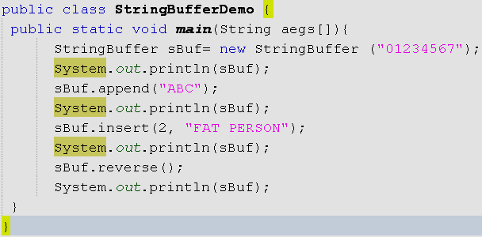

The StringBuffer - threadsafe
public final class StringBuffer extends Object
implements Serializable, CharSequence
Session 06 - Numbers and Strings

Slide 23
StringBuilder
public final class StringBuilder extends Object
implements Serializable, CharSequence
The StringBuilder class was introduced in 5.0. It is nearly identical to StringBuffer.
Major difference: string builders are not threadsafe.
If you want multiple threads to have concurrent access to a mutable string, use a string buffer.
If your mutable string will be accessed only by a single thread, there is an advantage to using a string builder, which will generally execute faster than a string buffer.
Session 06 - Numbers and Strings

Slide 24
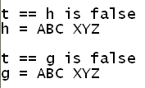
String Concatenation using String class
2 ways:
  String.concat() method.
  + operator.
String t = new String("ABC");
String h = t.concat(" XYZ");
System.out.println("t == h is " + (t==h));
System.out.println("h = " + h);
System.out.println();
String g = t + " XYZ";
System.out.println("t == g is " + (t==g));
System.out.println("g = " + g);
Session 06 - Numbers and Strings

Slide 25
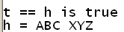
String Concatenation using StringBuffer or StringBuilder classes
1 way:
  StringBuffer.append().
StringBuffer t = new StringBuffer("ABC");
StringBuffer h = t.append(" XYZ");
System.out.println("t == h is " + (t==h));
System.out.println("h = " + h);
Session 06 - Numbers and Strings

Slide 26
Scanning Text
How to get data from a data source?
Data source
Memory variable
Keyboard
File
Getting data one after another
variables
Delimiters need to be omitted
The java.util.Scanner class
Class: java.util.Scanner
Data in data source are characters
Methods for getting data: next(), nextXXX()
Methods for checking availability of data : hasXXX()
Token: group of characters that has a meaning.
Notes:
Availability: sự có giá trị

Slide 27
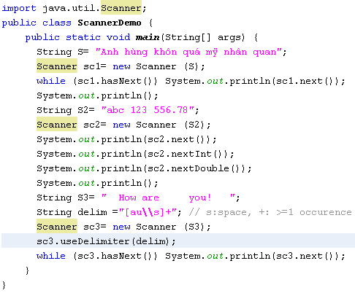

Scanning data from a string
The default delimiter is the blank character. You can designate delimiters.
[au\\s] means that a, u and space(\s) are delimiters.
+ means that number of occurrences is equal or greater than 1

Slide 28
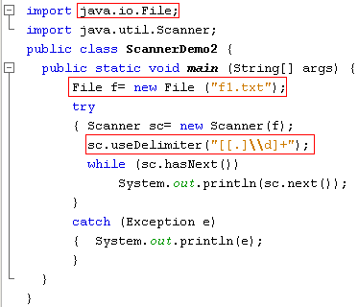

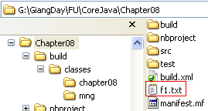

Scanning data from a text file
Specifying Delimiters
Add New File/ Other/ Empty File
File name: f1.txt
Common Patterns:
[ ] : representing a character
. (arbitrary character)
\d ( digits) \w ( word characters) \s (space)
Quantifiers: * (>=0) , + (>=1) , ? (zero or one)
[a-zA-Z ] : a character from a to z or A to Z
Read java documentation for more details
Class: java.util.regex.Pattern

Slide 29
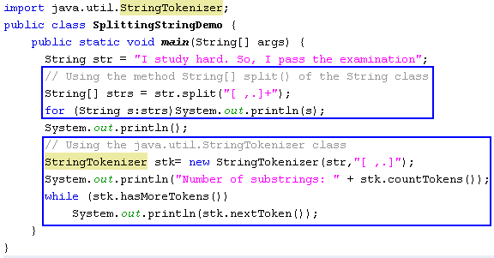
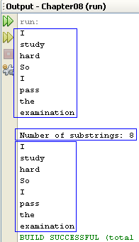
Splitting a string into substrings
The method split(delimiters) of the class String and
the java.util.StringTokenizer are used.

Slide 30
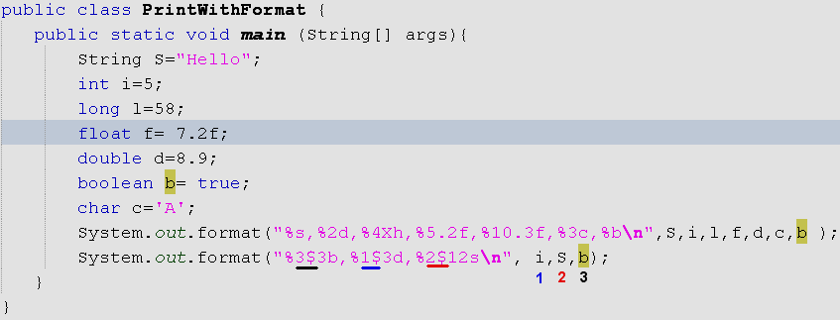

Formatting Output
%[argument_index$][flags][width][.precision]conversion
See API documentation for more details (api/java/util/Formatter.html#syntax).
Session 06 - Numbers and Strings

Slide 31
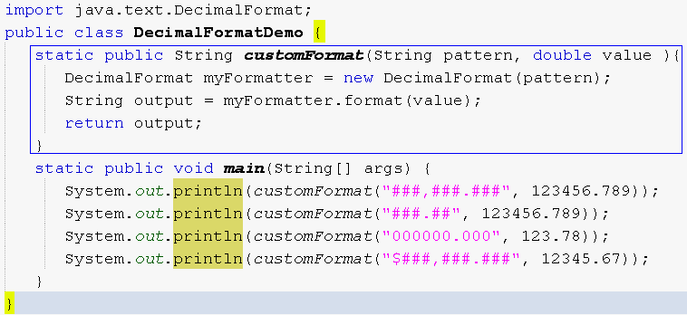

Formatting Output
Session 06 - Numbers and Strings

Slide 32
Summary
Working with Numbers:
  Wrapper classes: Number, Character
  The java.lang.Math class
  Autoboxing and unboxing .
The java.lang.Math
String class:
  Create and manipulate strings.
  Compares the String and StringBuilder classes.
Scanning Text
Formatting output
Session 06 - Numbers and Strings

